Slide 1
An Introduction to Flutter
Don Ward
Quicken Loans
Senior Research Engineer
donward@quickenloans.com
@donwardpeng

Slide 2


Who am I?
Led Quicken Loans Mobile Team for a few years
Recently finished 100 Days of Code on Flutter
Founder and Co-Lead GDG Detroit for 7 years
Founder and Leader of GDG Windsor ~ 1 year

Slide 3
The Agenda
What is Flutter?
What is Dart?
Why?
Let’s code!

Slide 4

What is Flutter?
Open Source Cross Platform Mobile Development
Announced 2015
Flutter 1.0 – Dec 2018
Flutter 1.5 – May 2019
Flutter 1.9 – Sept 2019
Available on iOS, Android, ChromeOS and Web
Julian Villafuerte, from Workforce Windsor-Essex

Slide 5
What is Dart?
Since 2011
Statically typed language similar to JavaScript and Java
Object-oriented
Syntactic sugar

Slide 6

‘Why?’

Slide 7
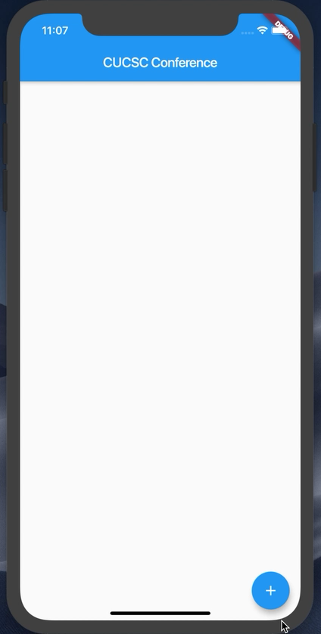
What are we building today?

Slide 8
Let’s start
Flutter SDK installed
Visual Studio Code installed
Android emulator or iOS simulator running
https://github.com/donwardpeng/flutter_intro_cucsc

Slide 9
Let’s talk about the Command Line Tool (CLI)
‘flutter doctor’
‘flutter create <app_name>’
In the <app_name> directory -> ‘flutter run’
Hot Reload and Restart
While running, type ‘h’

Slide 10
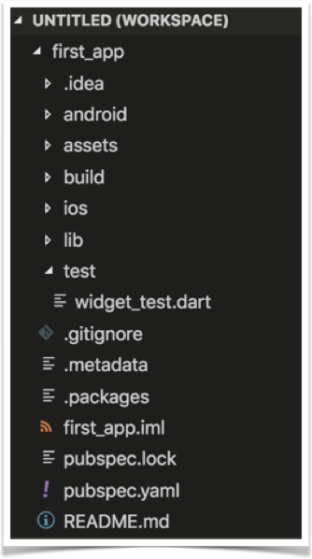
Project Structure

Slide 11
Let’s start from scratch
In VS Code, open the main.dart file
Wipe it clean
Add the code below
//Example 1
import 'package:flutter/material.dart';
void main() {}

Slide 12
Let’s attach something to the screen
The runApp method
In Dart, ‘=>’ is equivalent to {return expr};
//Example 2
import 'package:flutter/material.dart';
void main() => runApp(<Widget>);

Slide 13
‘Let’s talk about Widgets’

Slide 14
Widgets
Everything is a widget
Stateless – display only
Stateful – maintains some internal state
class StatelessWidgetExample extends StatelessWidget{};
class StateFullWidgetExample extends StatefulWidget{};

Slide 15
Let’s create our first Widget
//Example 3
import 'package:flutter/material.dart';
void main() => runApp(MyApp());
class MyApp extends StatelessWidget{
@override
Widget build(BuildContext context) {
// TODO: implement build
return null;
}
}

Slide 16
Let’s add some Material Design
//Example 4
@override
Widget build(BuildContext context) {
return MaterialApp(
title: ‘CUCSC Conference’,
);
}
}

Slide 17
‘Let’s talk about Constructors!’

Slide 18
Widgets & Constructors
Positional and Named Parameters
Flutter -> heavily relies on Named Parameters
Named Parameters declared with {}
Example – the Text Widget

Slide 19
The Text Widget
Text(String data, { Key key, TextStyle style, StrutStyle strutStyle, TextAlign textAlign, TextDirection textDirection, Locale locale, bool softWrap, TextOverflow overflow, double textScaleFactor, int maxLines, String semanticsLabel })

Slide 20
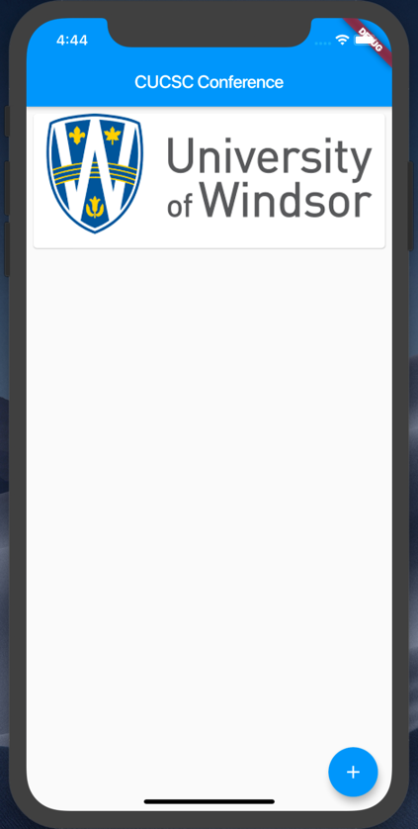
Let’s add some Widgets
Add a Card per Image
Add a Floating Action Button

Slide 21
Add a Scaffold for the Screen
//Example 5
return MaterialApp(
title: 'CUCSC Conference',
home: Scaffold(
appBar: AppBar(
title: Text('CUCSC Conference'),
),
));

Slide 22
Add a Card to the Body
//Example 6
home: Scaffold(
appBar: AppBar(title:Text(‘CUCSC Conference’),),
body: Card(child: ,));
}
}

Slide 23
Add a Column to the Card
//Example 7
... appBar: AppBar(
title: Text(‘CUCSC Conference’),
body: Card(child: Column(children: <Widget>[],),
),
));
}...

Slide 24


Let’s add some images
Steps:
Create a new assets folder and add images
Modify pubspec.yaml file

Slide 25
Add a Image to the Card
//Example 8
...
child: Column(
children: <Widget>[
Image.asset(‘assets/cucsc.png'),
],
),...

Slide 26
Guess what – Padding is a Widget
//Example 9
Below the Image...
Padding(padding: const EdgeInsets.all(8),
),
],
),
)));...

Slide 27
Margin is inside a Widget
//Example 10
...
body: Card(
margin:EdgeInsets.all(8),
child: Column(
children: <Widget>[
Image.asset(‘assets/cucsc.png'),
...

Slide 28
ListViews give us scroll
//Example 11
...
body: ListView(
children: <Widget>[
Card(
margin: EdgeInsets.all(8),
child: Column(
...

Slide 29
Stacks give us absolute position
//Example 12
...
body: Stack(
children: <Widget>[
ListView(
children: <Widget>[...

Slide 30
Let’s add a FAB
//Example 13
<Card View code above here>...
),
FloatingActionButton(
child: const Icon(Icons.add),
onPressed: () {},
)
],
)));...
<code below here>

Slide 31
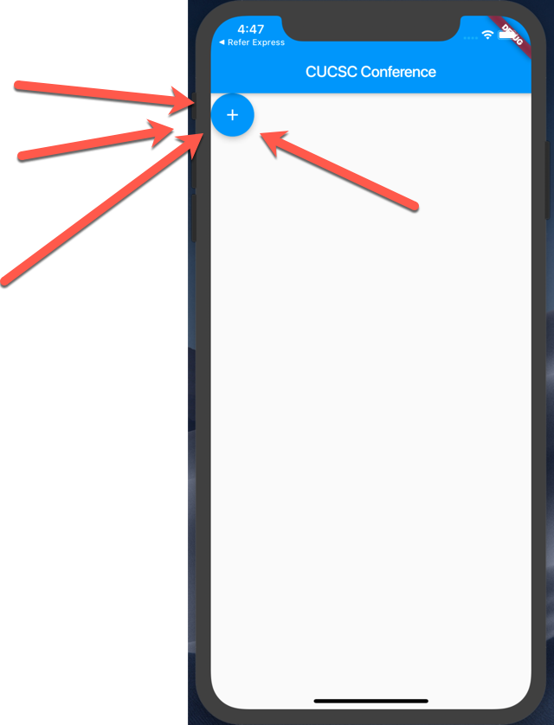
Why is the Floating Action Button (FAB) here?

Slide 32
Let’s move the FAB
//Example 14
<CardView code above here>
Positioned(
bottom: 16.0, right: 16.0,
child: FloatingActionButton(...

Slide 33
Everything is in place now. Let’s wire up the button and images to the list.
WARNING: BOILERPLATE CODE AHEAD

Slide 34
Let’s add a list of Images
//Example 15
class MyApp extends StatelessWidget {
// Declare a set list of images to cycle through
final List<Image> _itemImages = [
Image.asset('assets/cucsc.jpeg'),
Image.asset('assets/u_of_w.png'),
Image.asset(‘assets/vacation.jpg')
];
int _index = 0;
List<Image> _listOfImagesForScreen = [];

Slide 35
Boiler Plate Alert – A Stateful Class
//Example 16
class MyApp extends StatefulWidget {
@override
State<StatefulWidget> createState() {
return _MyAppState();
}
}
class _MyAppState extends State<MyApp> {

Slide 36
Let’s make the button do something
//Example 17
//Add to the main class above the build method
void onButtonPressed() {
setState(() {
_index++;
if (_index >= _itemImages.length) {
_index = 0;
}
_listOfImagesForScreen.add(_itemImages[_index]);
print('Item Name = ' + _listOfImagesForScreen.toString());
})}

Slide 37
Redraw the ListView with all of the Images every time state changes
//Example 18
ListView(
children: _listOfImagesForScreen.map((element) => Card(

Slide 38
What did we learn?
Command Line Tool for Flutter
Project Structure
Widgets
Constructors and Named Parameters
Stateless and Stateful Widgets
A few Widgets ☺
https://github.com/donwardpeng/flutter_intro_cucsc

Slide 39

Thank you!
Don Ward
Quicken Loans
Senior Research Engineer
donward@quickenloans.com

